Slide 1



DESANTHIRI
---Right one starts here…
Devex Members:
PRAVEENA S
SACHIN DHANUSH N
SIDDHARTH A
SNEHA SRI R
SUNDARAN N
A DEVEX JOURNEY STARTS………..

Slide 2
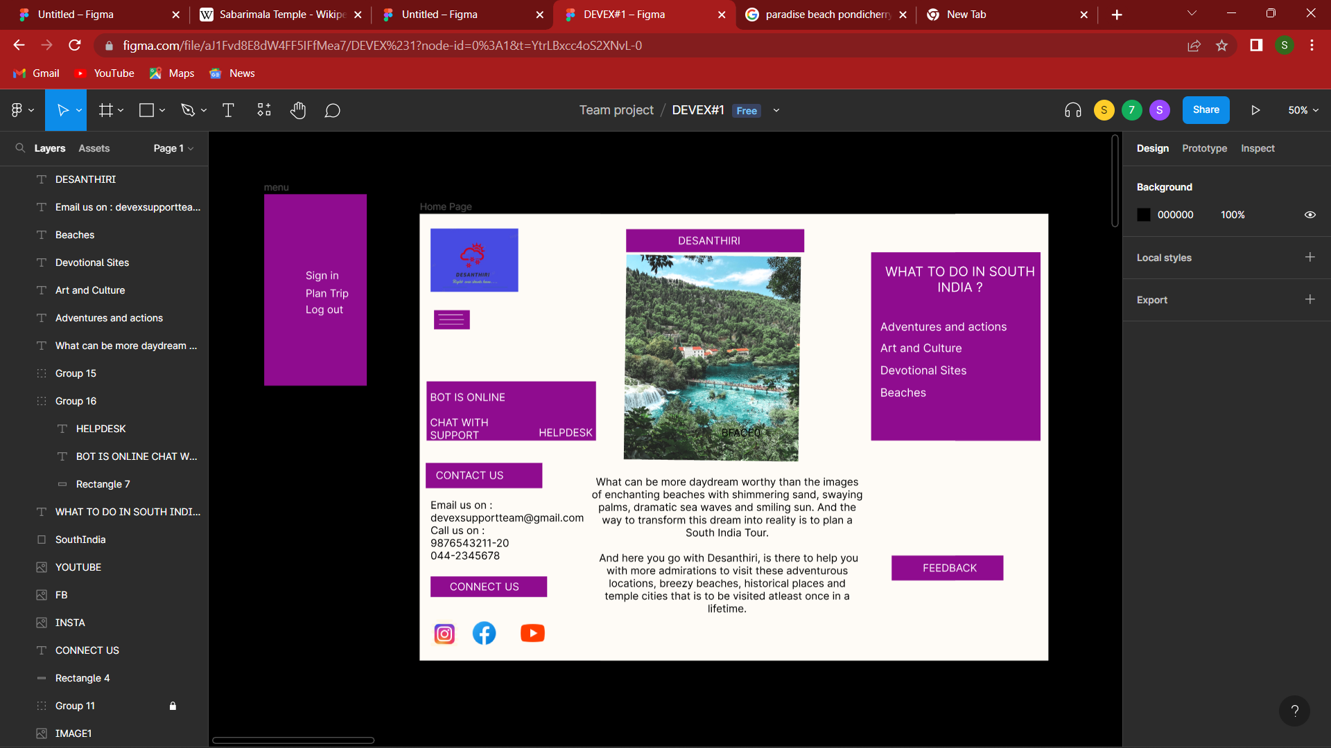

Slide 3
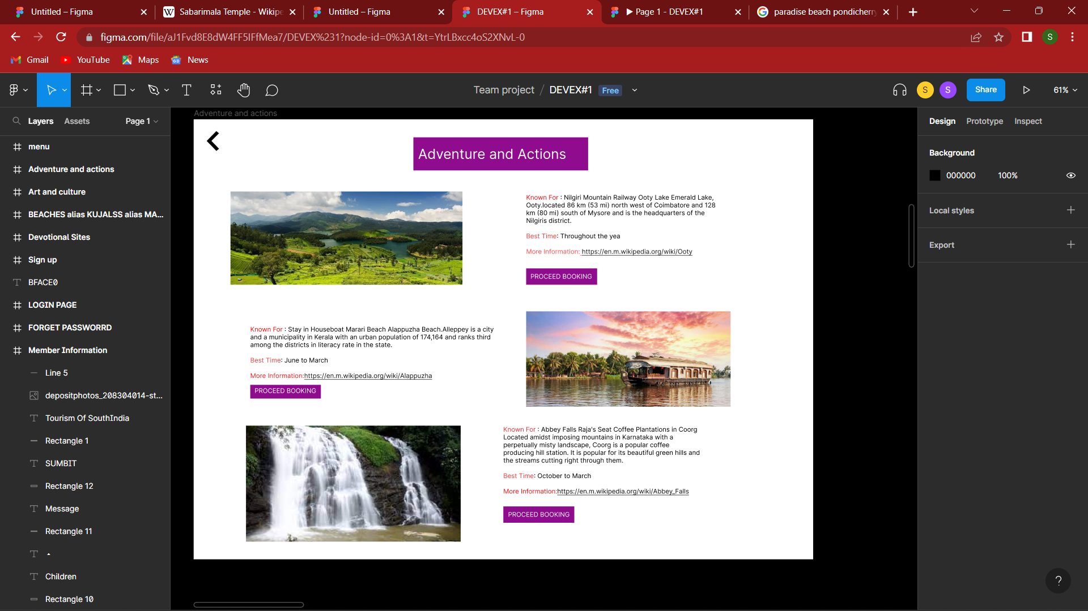

Slide 4
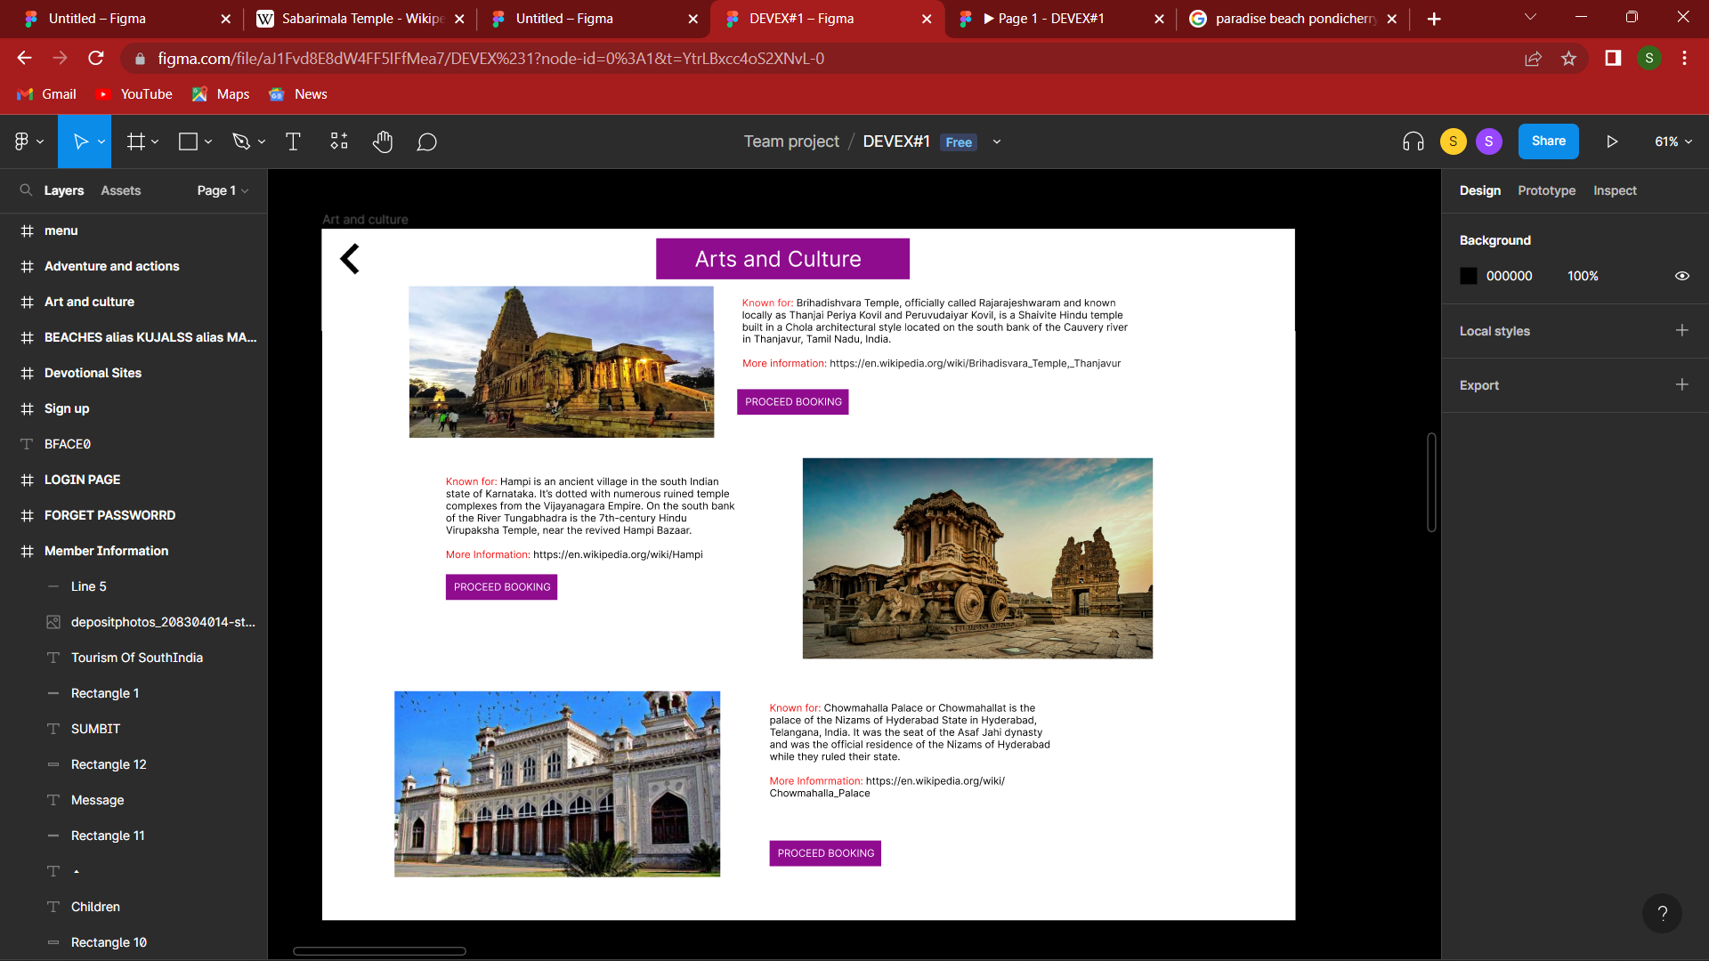

Slide 5
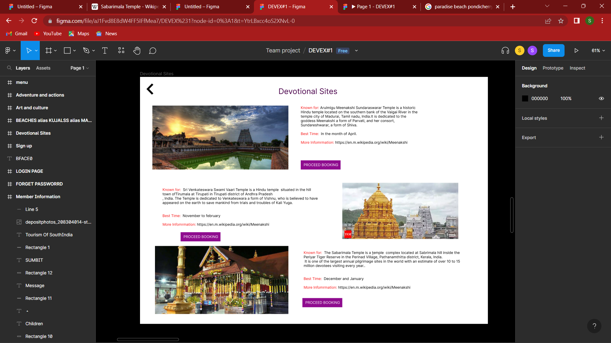

Slide 6
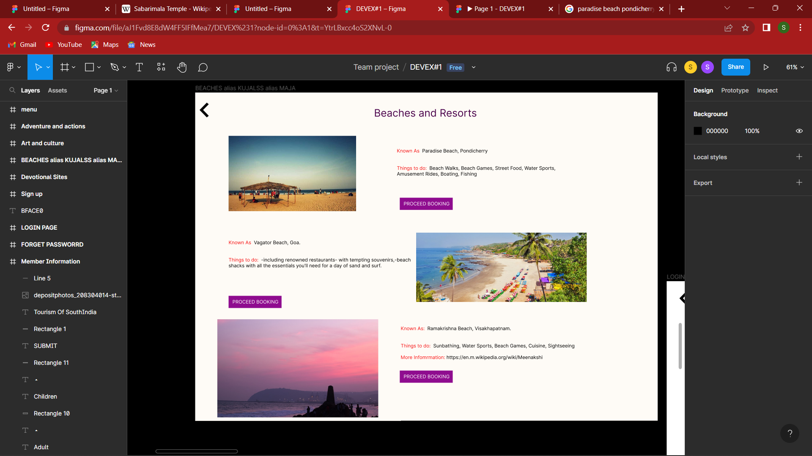

Slide 7
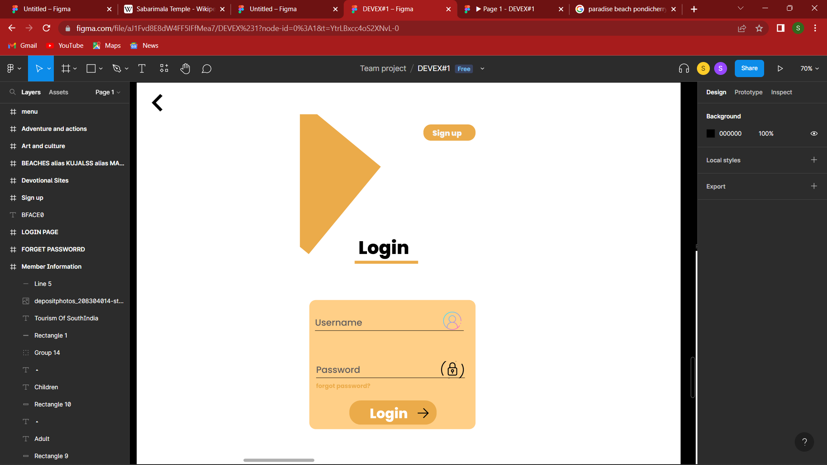
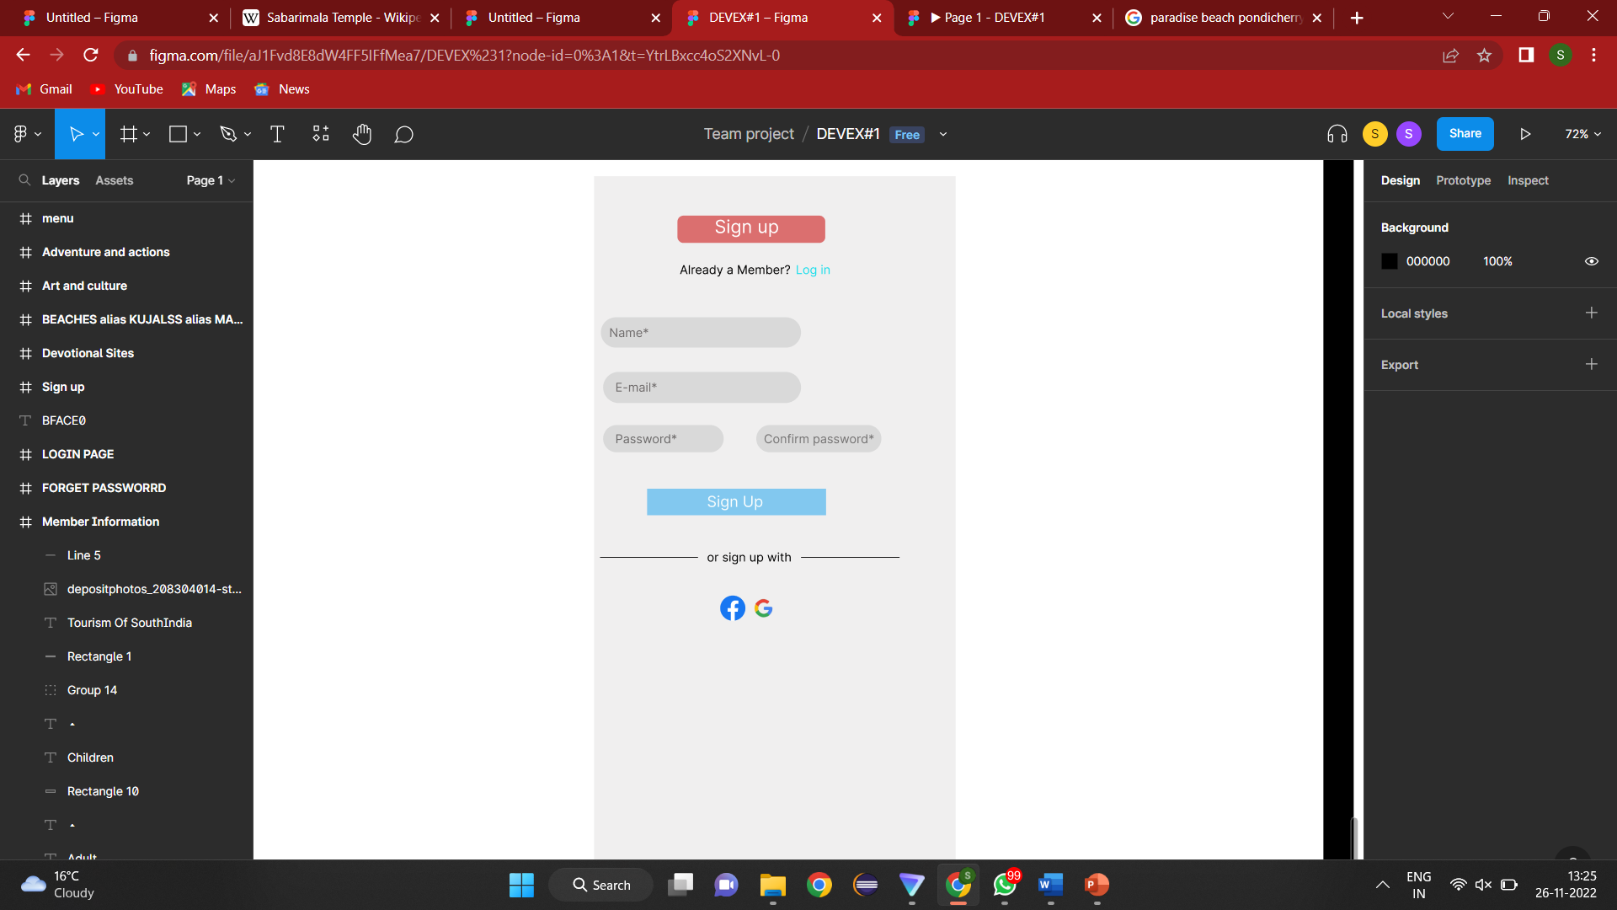
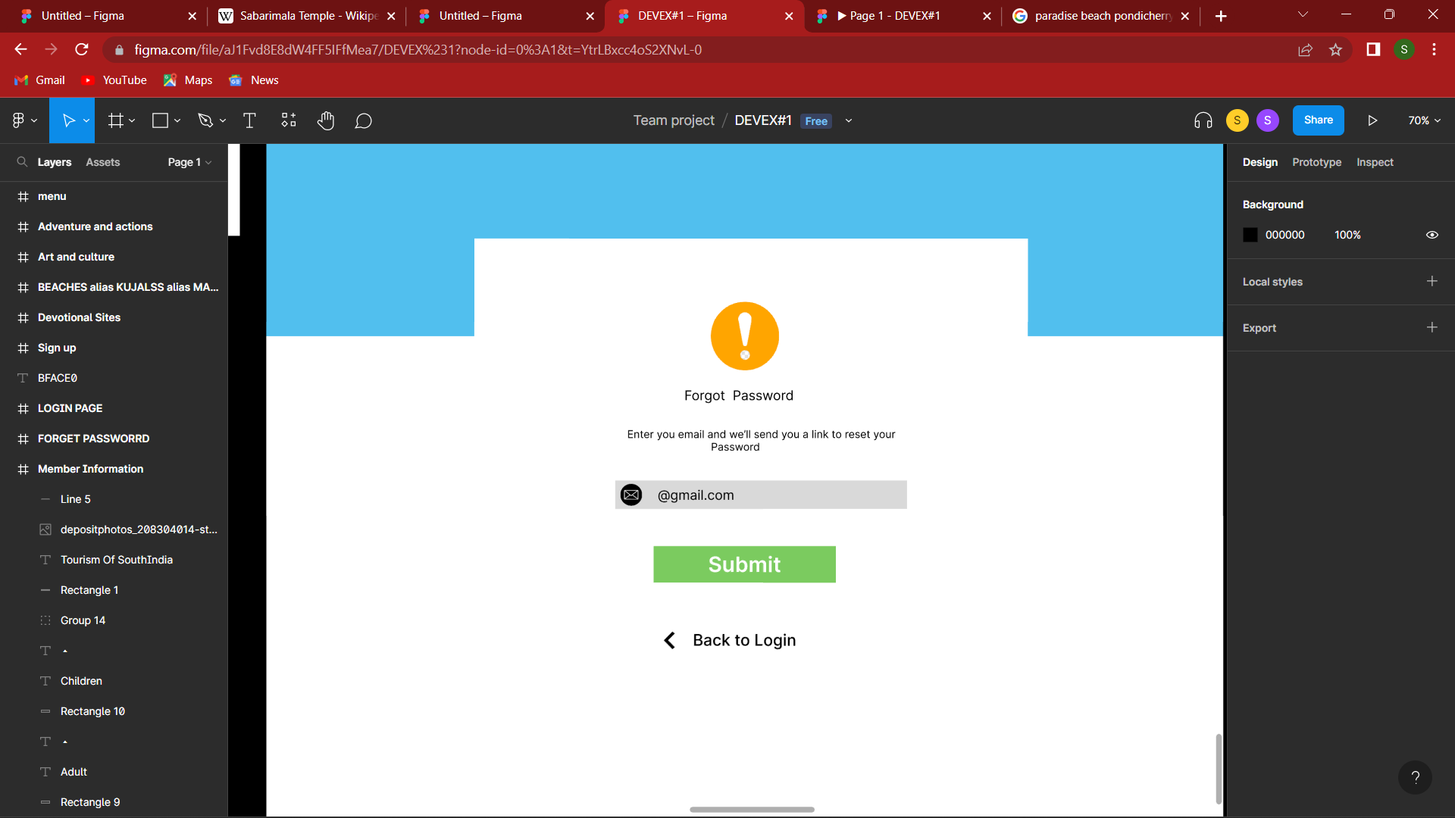

Slide 8
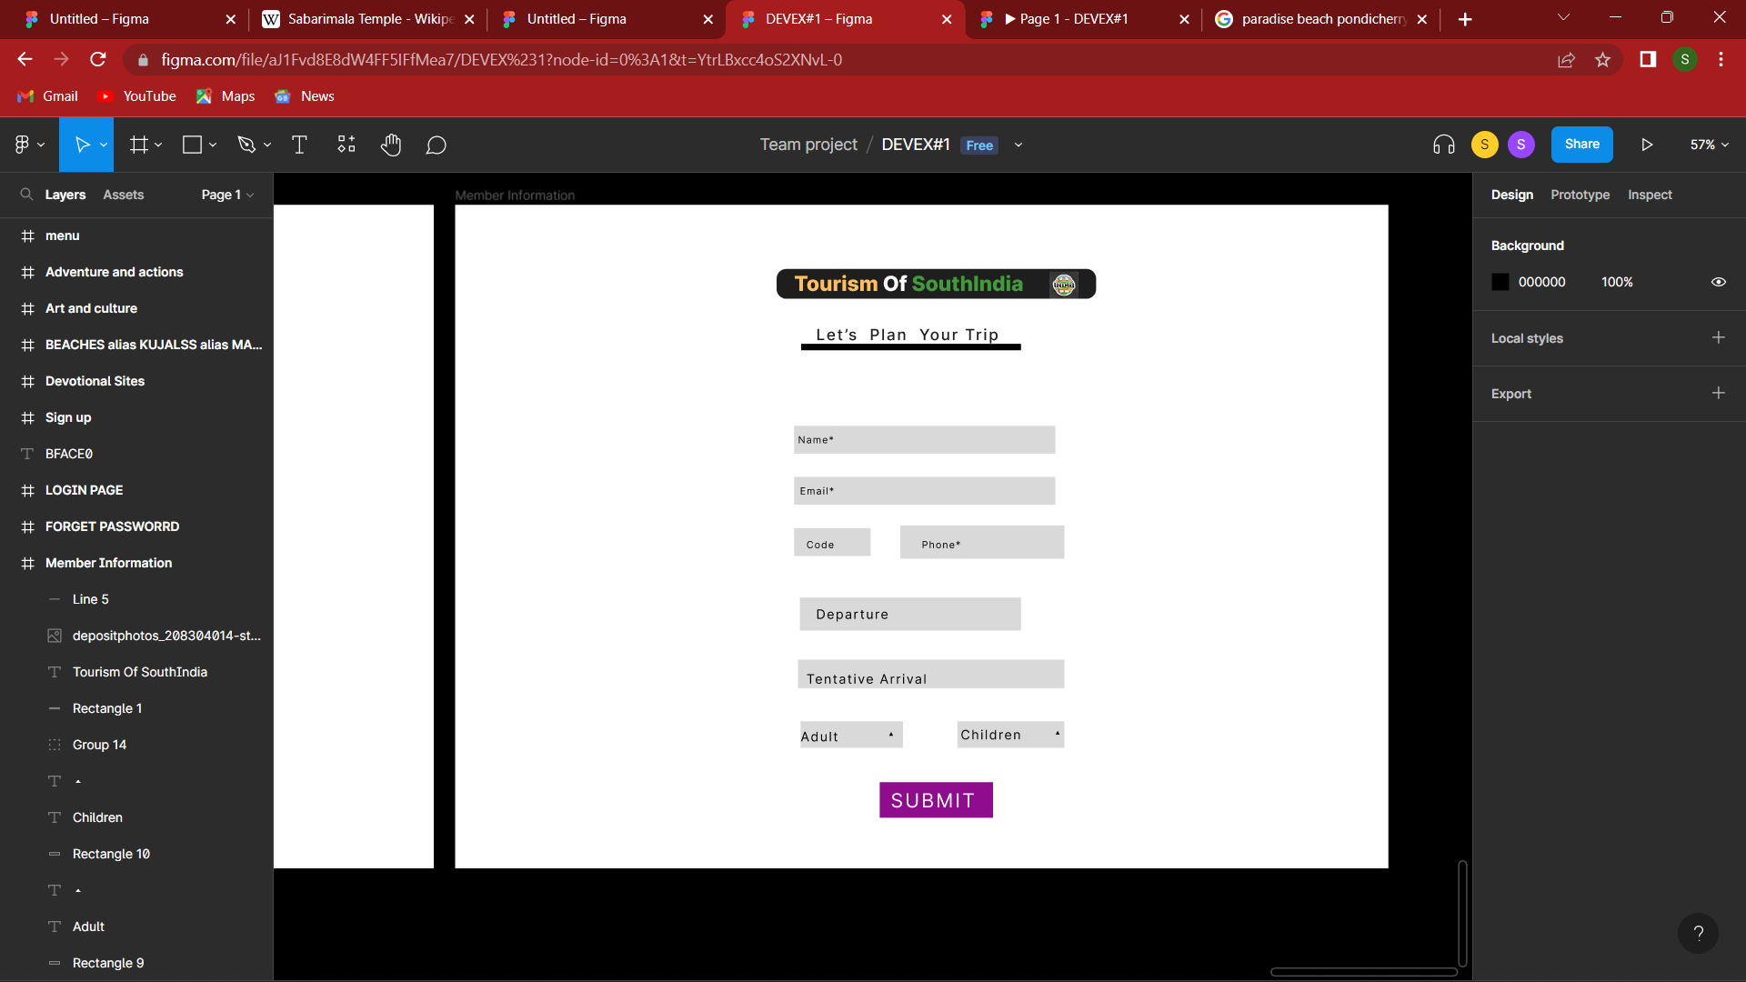

Slide 9
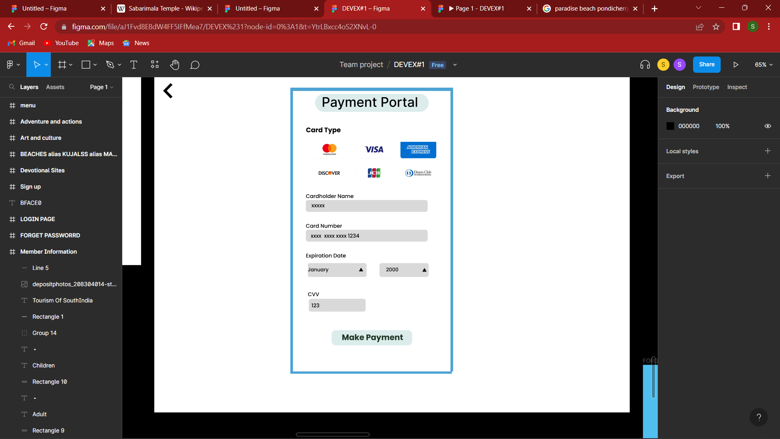

Slide 10
GITHUB LINK :
https://github.com/PRAVEENA-SENTHIL/Desanthiri.git
FIGMA LINK:
https://www.figma.com/proto/aJ1Fvd8E8dW4FF5IFfMea7/DEVEX%231?node-id=29%3A6&scaling=min-zoom&page-id=0%3A1&starting-point-node-id=29%3A6

Slide 11


